Slide 1

Ho Chi Minh City University of Transport
Image Processing and Computer Vision
INTRODUCTION
Tran Le Anh
anhtl@ut.edu.vn
03-2025

Slide 2
Introduction
Evolution
Image Processing

Slide 3
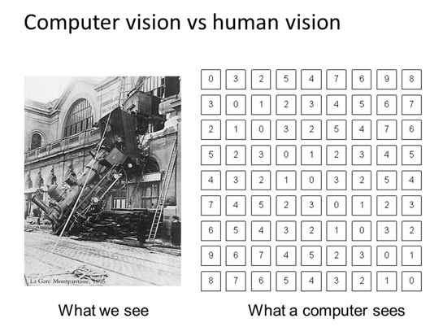
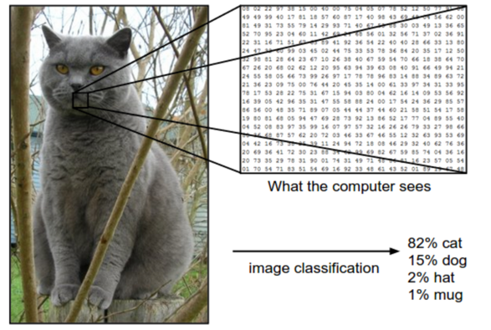
Introduction
Computer Vision
Computer vision is a field of computer science that focuses on enabling computers to identify and understand objects and people in images and videos.
Source: https://azure.microsoft.com/en-us/resources/cloud-computing-dictionary/what-is-computer-vision

Slide 4
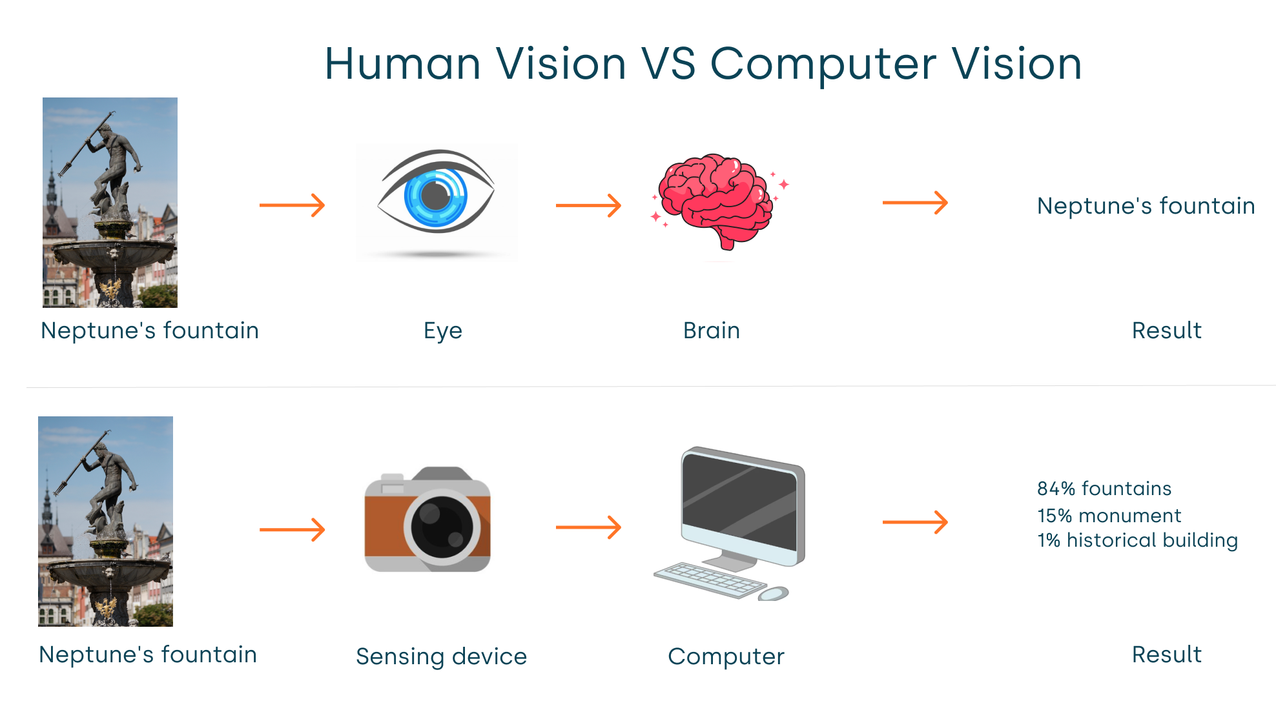
Introduction
Computer Vision

Slide 5
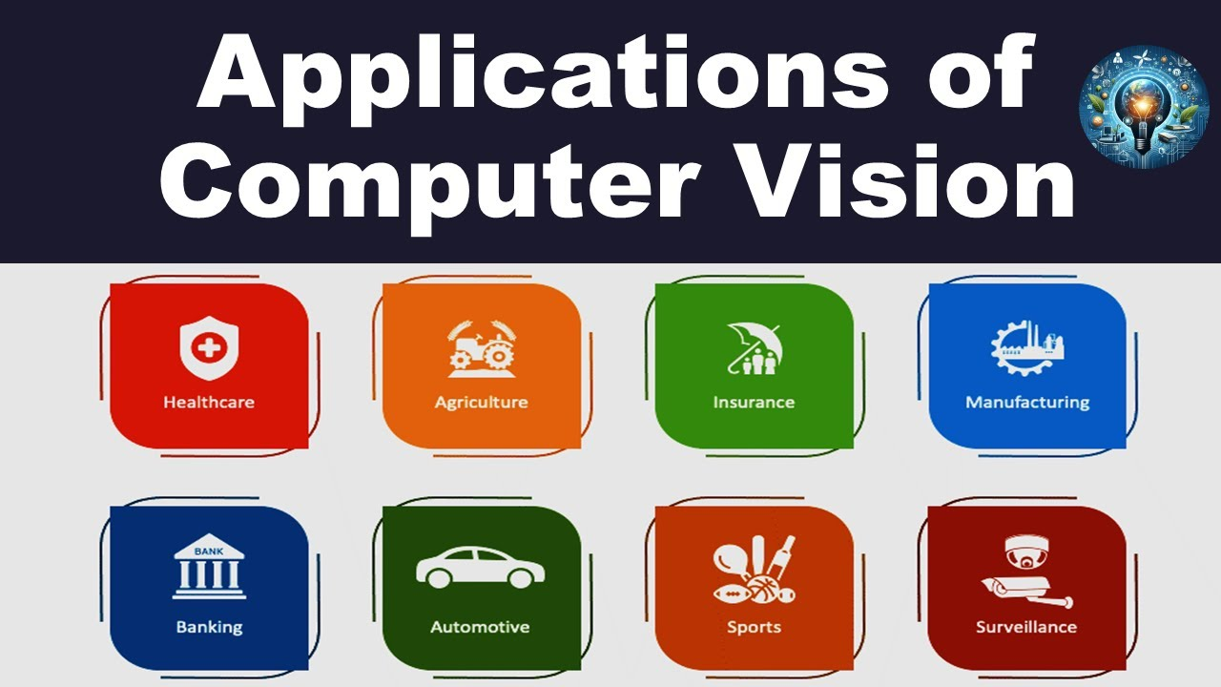
Introduction
Applications

Slide 6
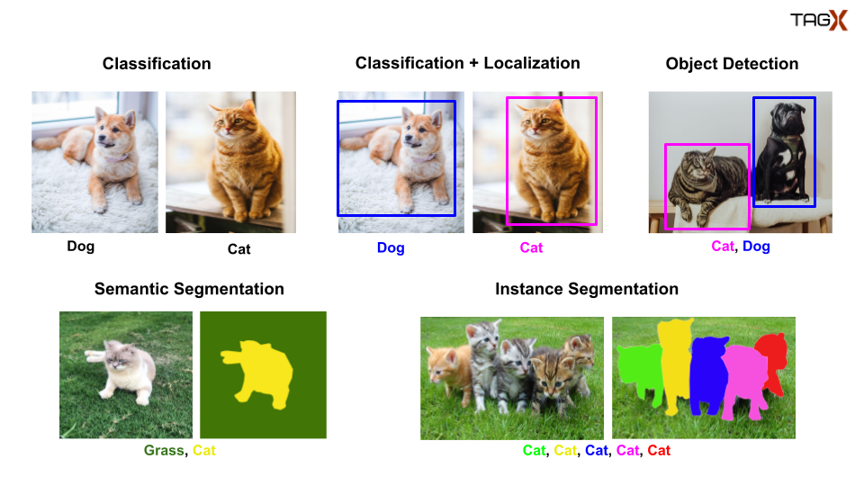
Introduction
Tasks

Slide 7
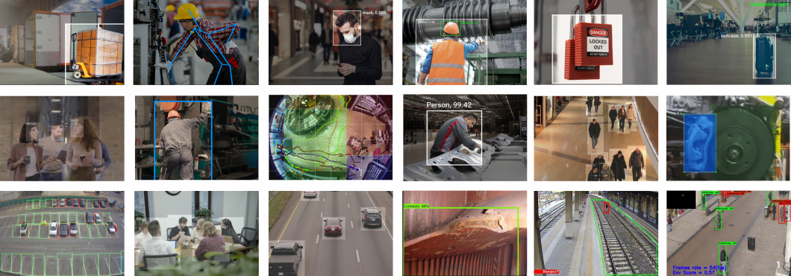
Introduction
Tasks

Slide 8
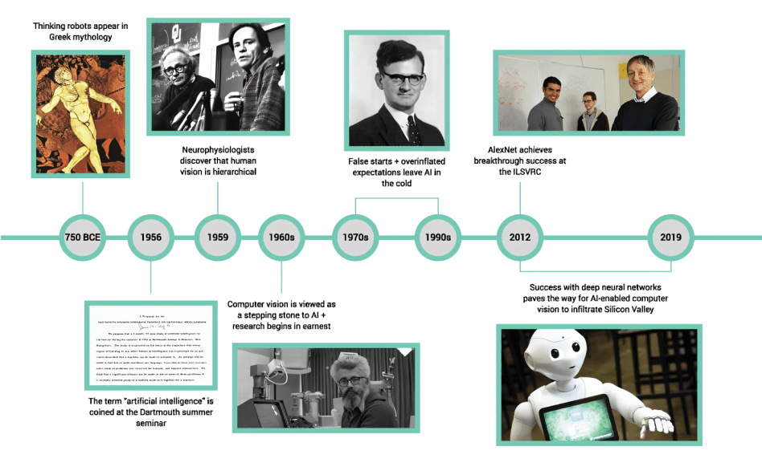
Evolution
History
Ref: https://letsdatascience.com/learn/history/history-of-computer-vision/

Slide 9
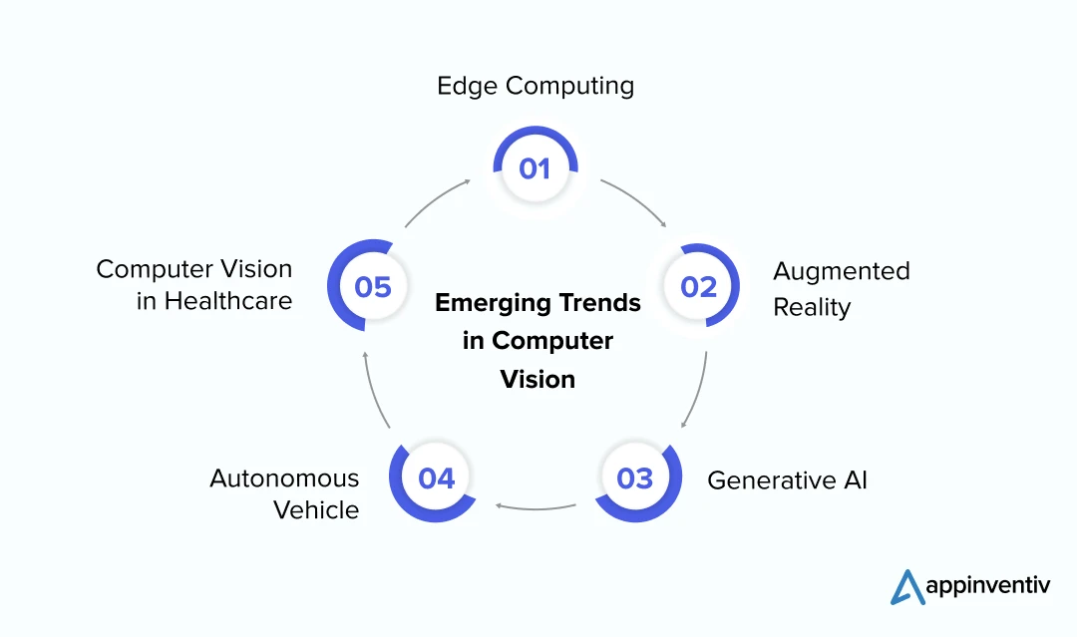
Evolution
Trends

Slide 10
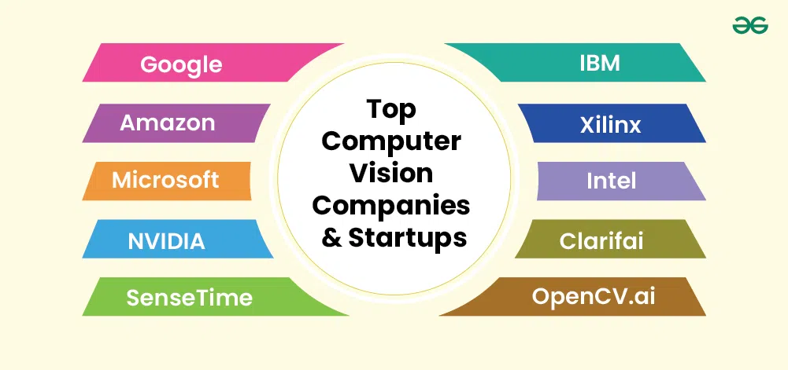
Evolution
Companies

Slide 11
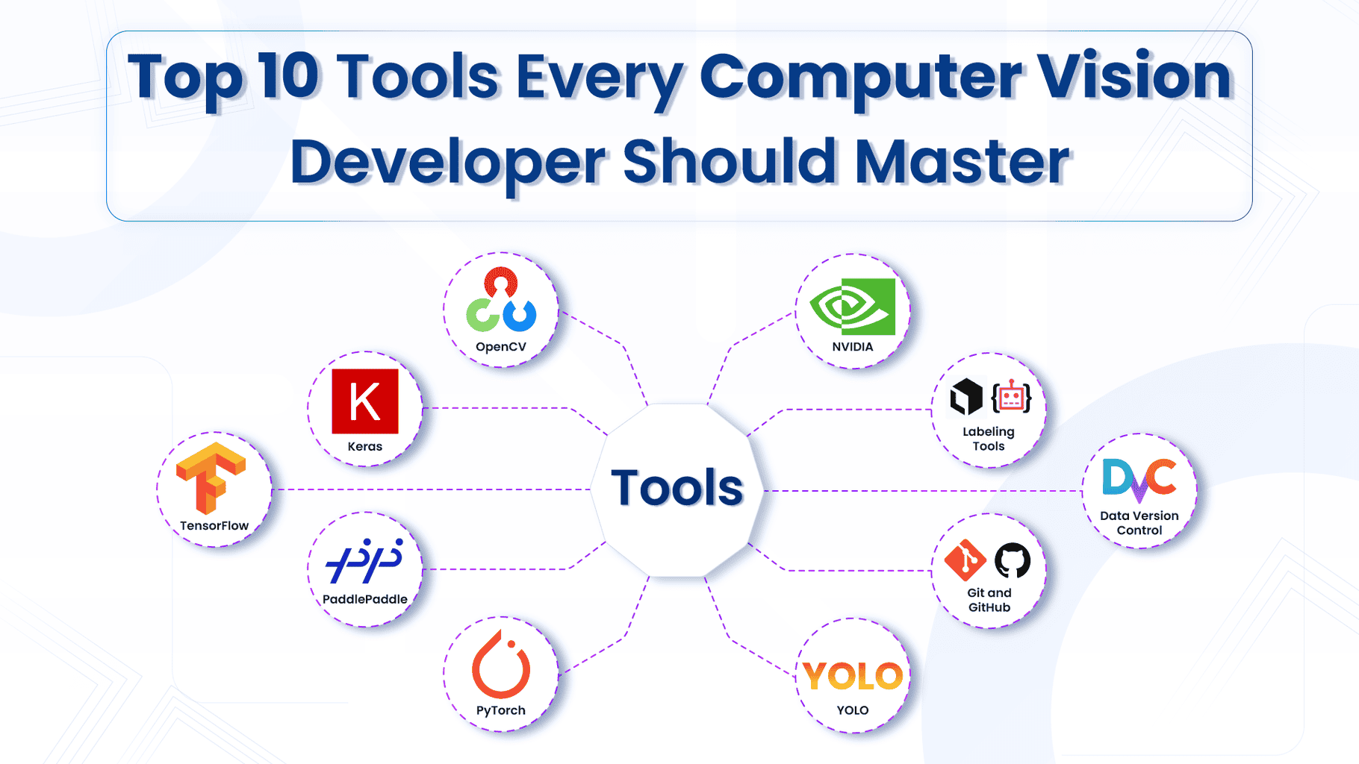
Evolution
Tools

Slide 12
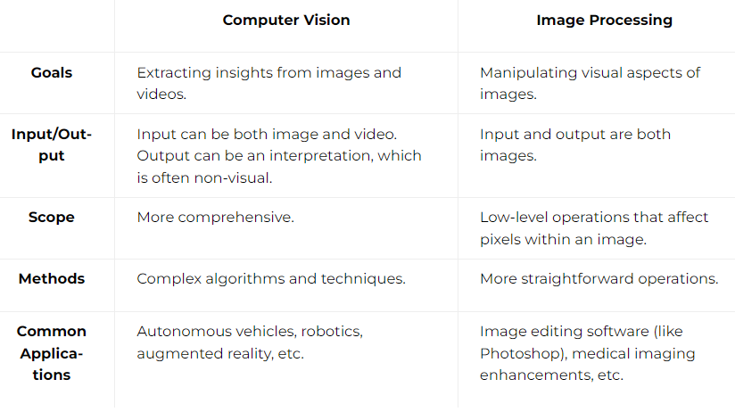
Image Processing
Computer Vision vs Image Processing

Slide 13
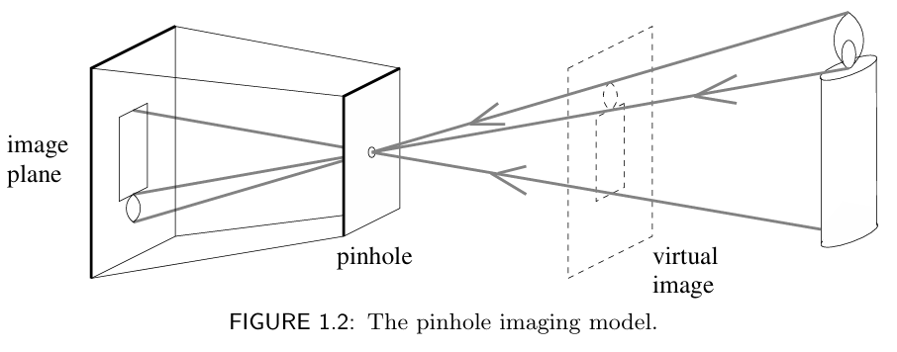
Image Processing
Image Formation

Slide 14
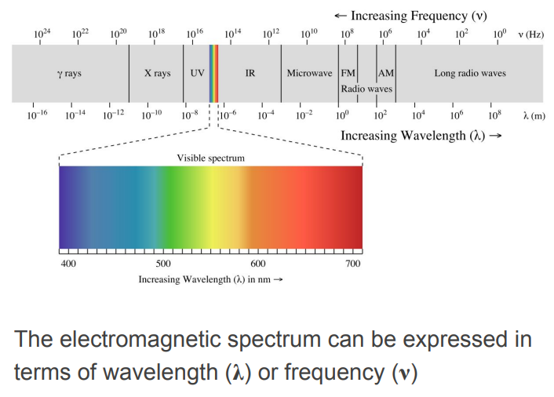
Image Processing
Image Formation

Slide 15
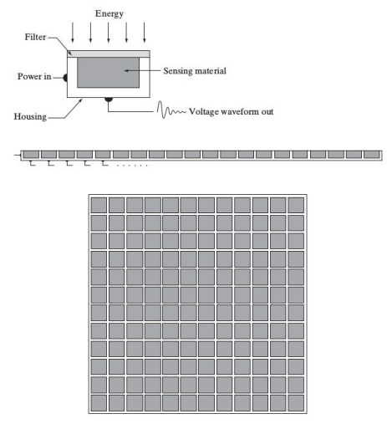
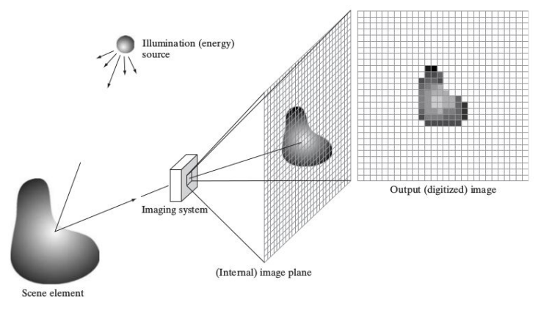
Image Processing
Image Formation

Slide 16
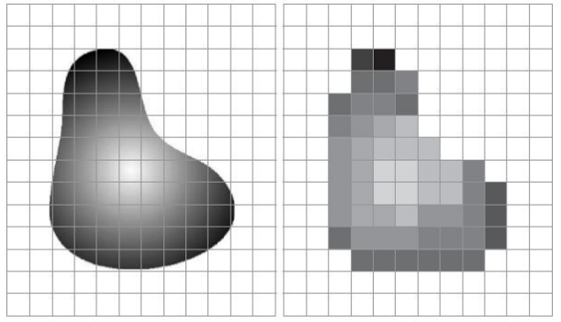
Image Processing
Image Formation
Real Object
Image

Slide 17
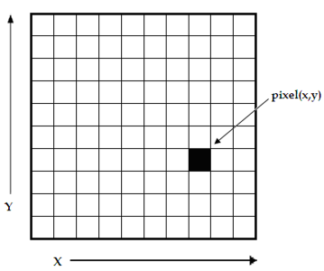
Image Processing
Image Formation
Pixel is tiny units in images, storing color and brightness values.
The pixel value array is 2-dimensional.
It defines a single rectangle of pixel values.
A single layer of pixel values represents a grayscale image.

Slide 18
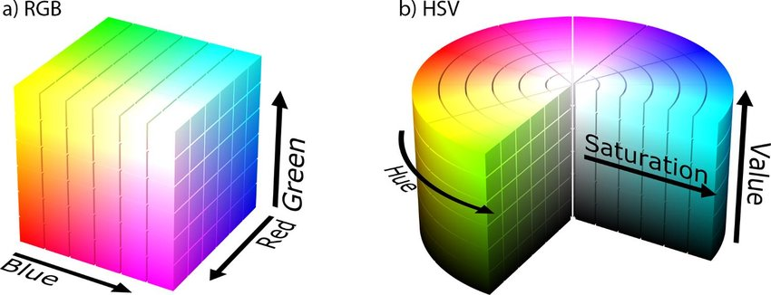
Image Processing
Color Spaces

Slide 19
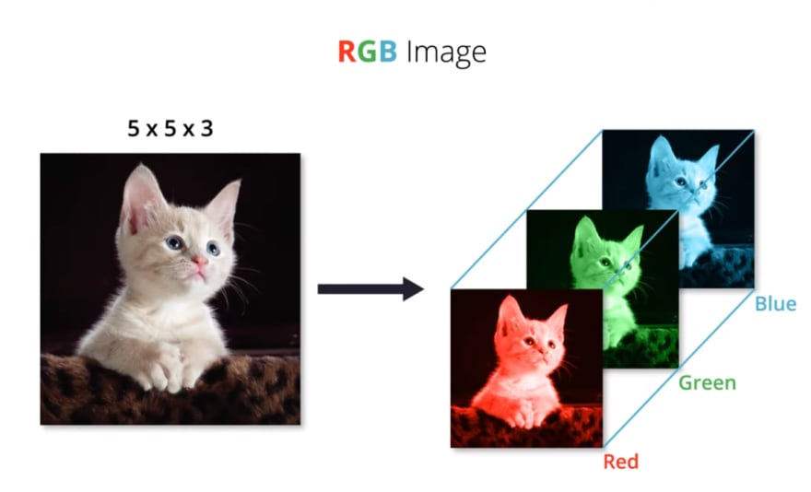
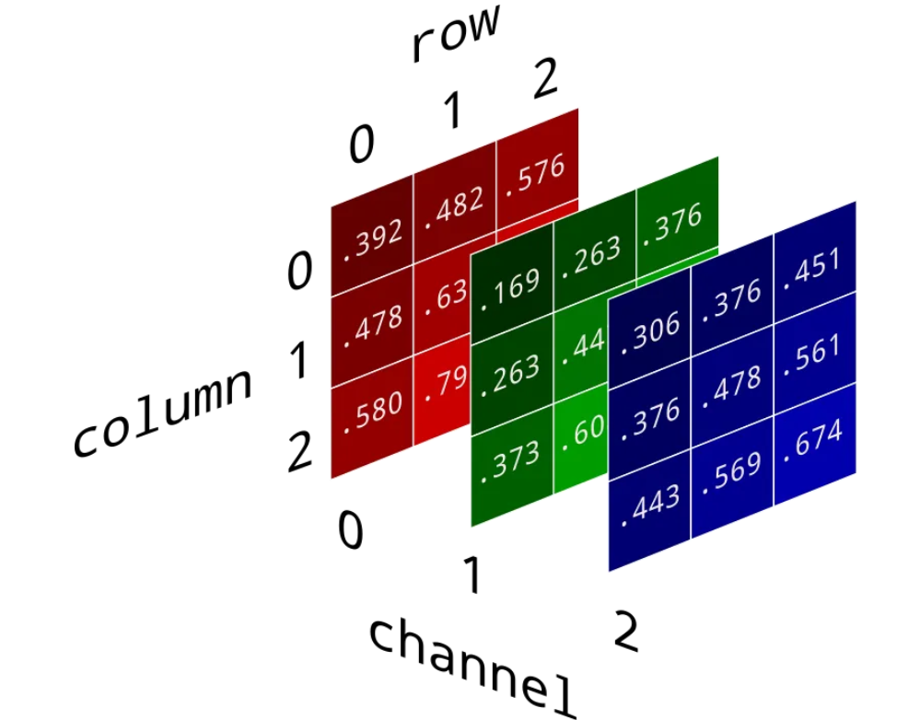
Image Processing
RGB

Slide 20
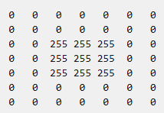
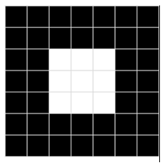
Image Processing
Image Resolution
This array has 7 rows and 7 columns, representing a 7x7 image (8-bit).
Each pixel value ranges from 0 (black) to 255 (white).

Slide 21
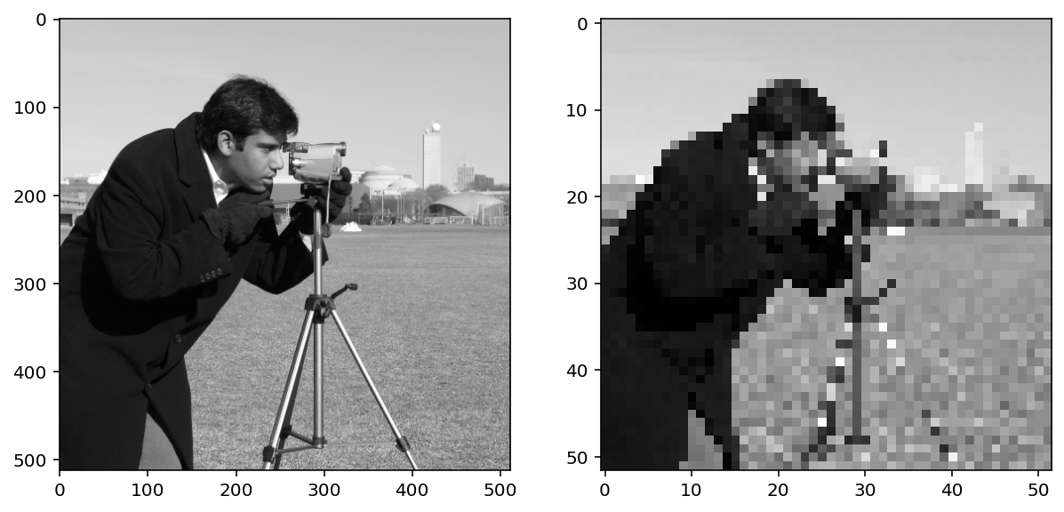
Image Processing
Image Processing
Image processing task is to apply filters that modify pixel values of the image to create a visual effect.
Input
Output

Slide 22
Image Processing
Image Processing
Image processing task is to apply filters that modify pixel values of the image to create a visual effect.
Input
Output

Slide 23
Image Processing
Practice
- Download and Install Python
- Verify and Upgrade Pip
- Install OpenCV using Pip

Slide 24
Thank You
anhtl@ut.edu.vn

